Slide 1
Parallelized Algorithm for Persistent Feasibility in Linear Systems with Multiple, External Switching Signals
Richard Arlen Hall, Dr. Leila Bridgeman
2022 – IEEE CDC

Slide 2
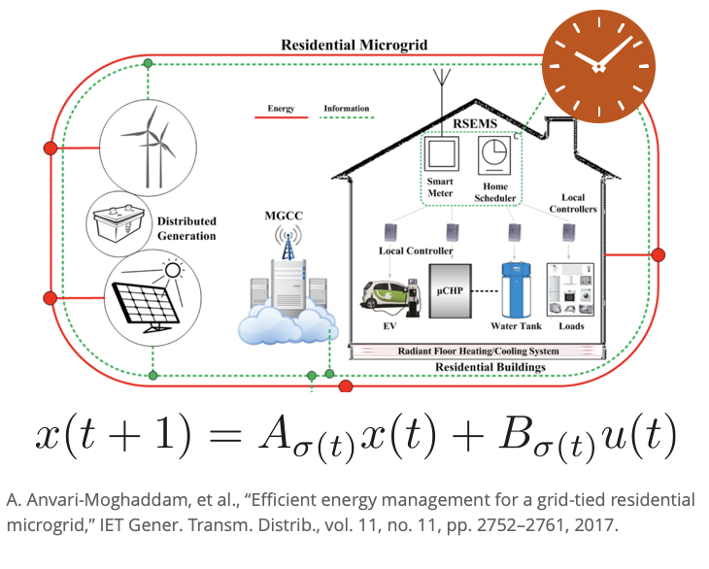
Introduction
Illustrative Example
Consider a simple microgrid.
Limited resources could lead to loss of power.

Slide 3
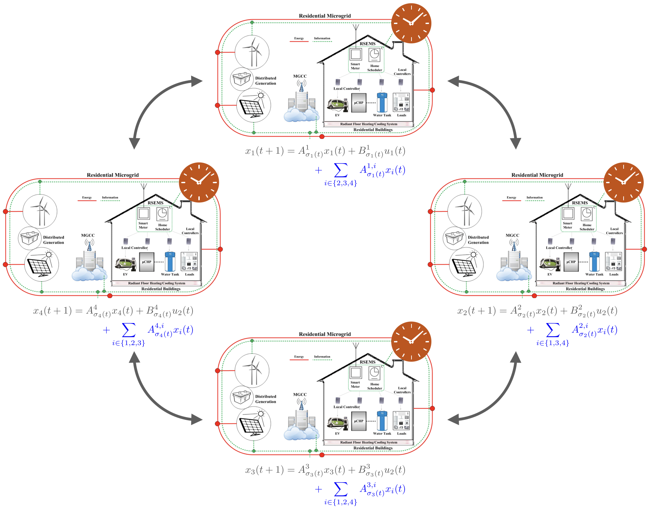
Introduction
Illustrative Example
Consider a simple microgrid.
Limited resources could lead to loss of power.
We could connect multiple systems.
?

Slide 4
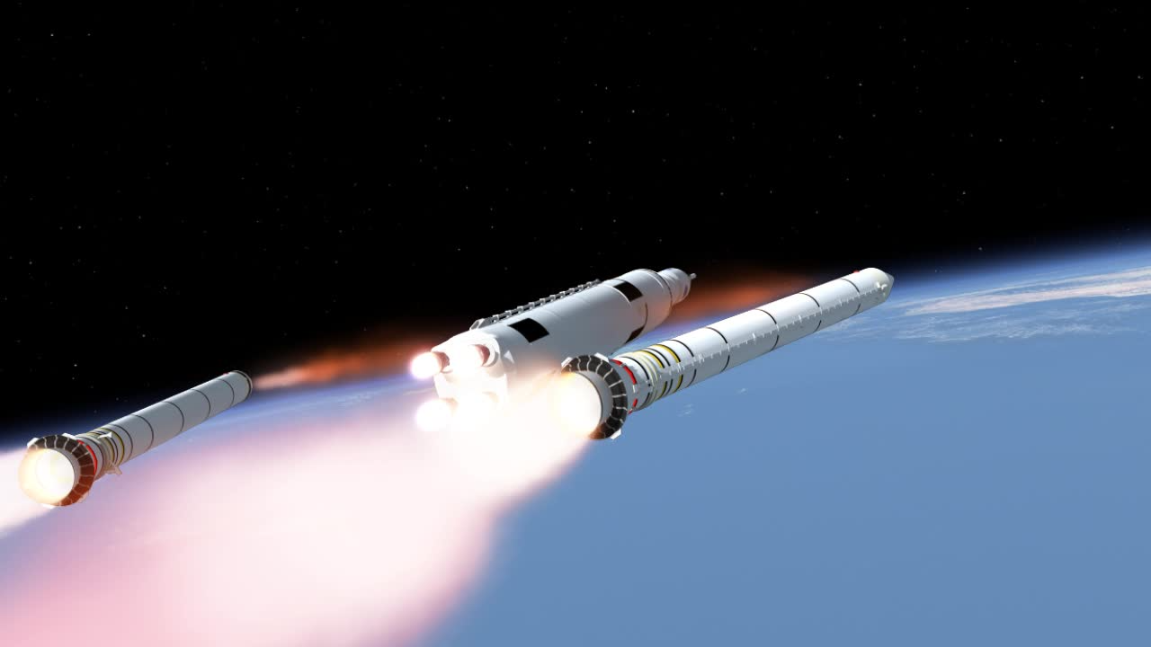
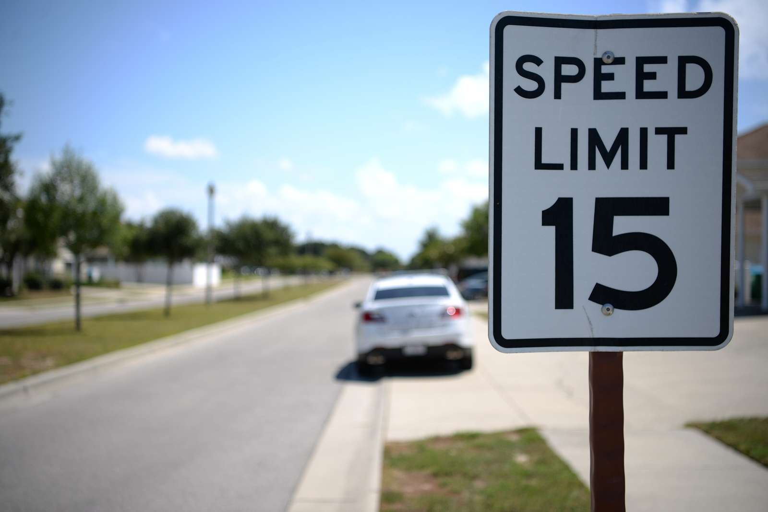
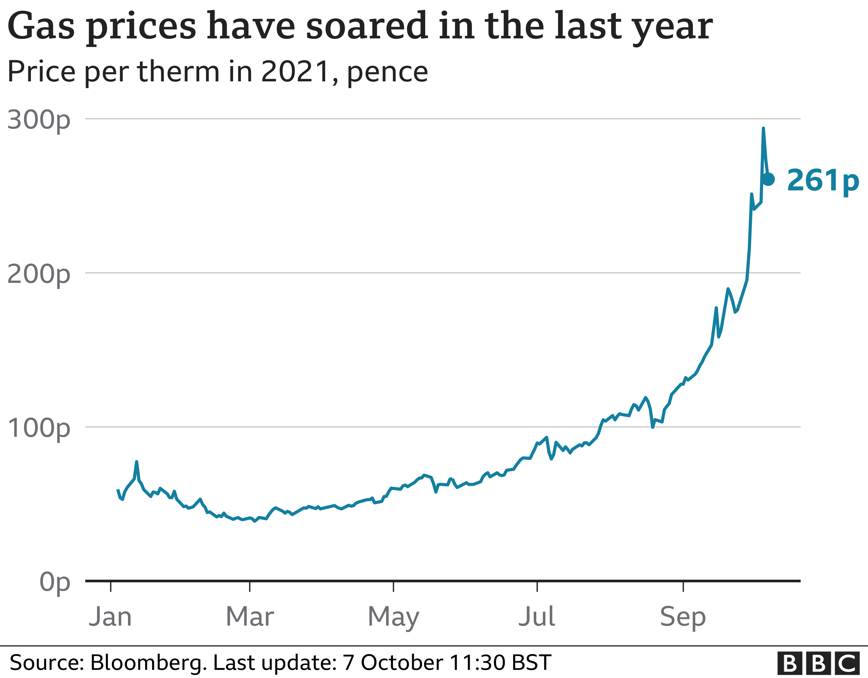
Introduction
Externally Switched Systems
The single microgrid was an example of an Externally Switched System.
Special class of hybrid systems:
State-based:
Time-based:
Switch in dynamics
Switch in constraints
Switch in objectives

Slide 5

Introduction
Externally Switched Systems - Feasibility
Goal: Find states that
Respect state constraints for current mode, and
Can respect state constraints for any possible new mode.
Problem is helped by constraints on the switching signals.
When can the
system switch?
Which modes can be switched between?

Slide 6
Introduction
Externally Switched Systems - Feasibility
Goal: Find states that
Respect state constraints for current mode, and
Can respect state constraints for any possible new mode.
Example: A car under a 25 m/s speed limit can detect speed limit changes 45m beforehand. The speed limit can only change by 10 m/s at a time and the car can decelerate at 3.125 m/s^2. How fast can the car be going so that it will never violate new speed limits?
Naive state constraints: 0 <= v <= 25
Safe-set state constraints: 0 <= v <= 22.5
Add figure

Slide 7
Introduction
Externally Switched Systems - Feasibility
Goal: Find states that
Respect state constraints for current mode, and
Can respect state constraints for any possible new mode.
Problem is helped by constraints on the switching signals described as directed graphs.
Example mode sequence from node a:
1-1-1-3-3-2
Valid sequence since path on graph exists

Slide 8
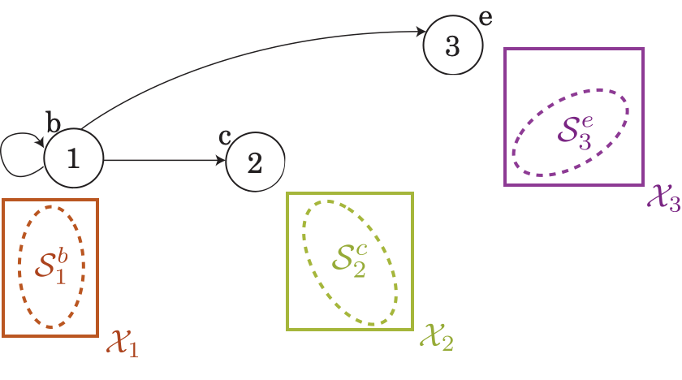
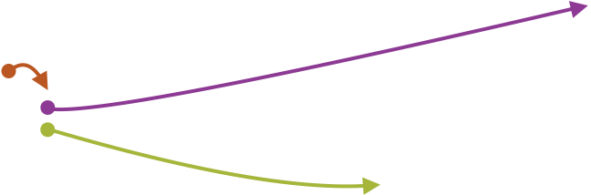
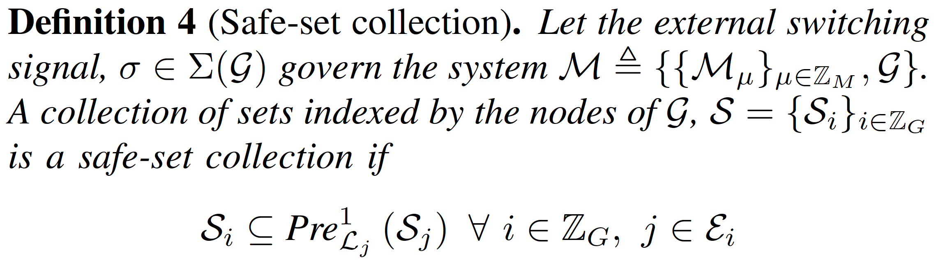
Introduction
Externally Switched Systems - Feasibility
Assign state constraints to each node.
Let inputs exist for every that will move the state into one of the successor sets depending on how the switching signal evolves.

Slide 9
Introduction
Externally Switched Systems - Feasibility
Algorithm

Slide 10
Introduction
Distributed Systems
Useful for making intractable problems tractable.
Two approaches:
Cooperative – work together for a global objective.
Non-cooperative – Work separately for local objectives.
Assumes a preview of disturbance, decreasing conservatism.
Add equations and Figure

Slide 11
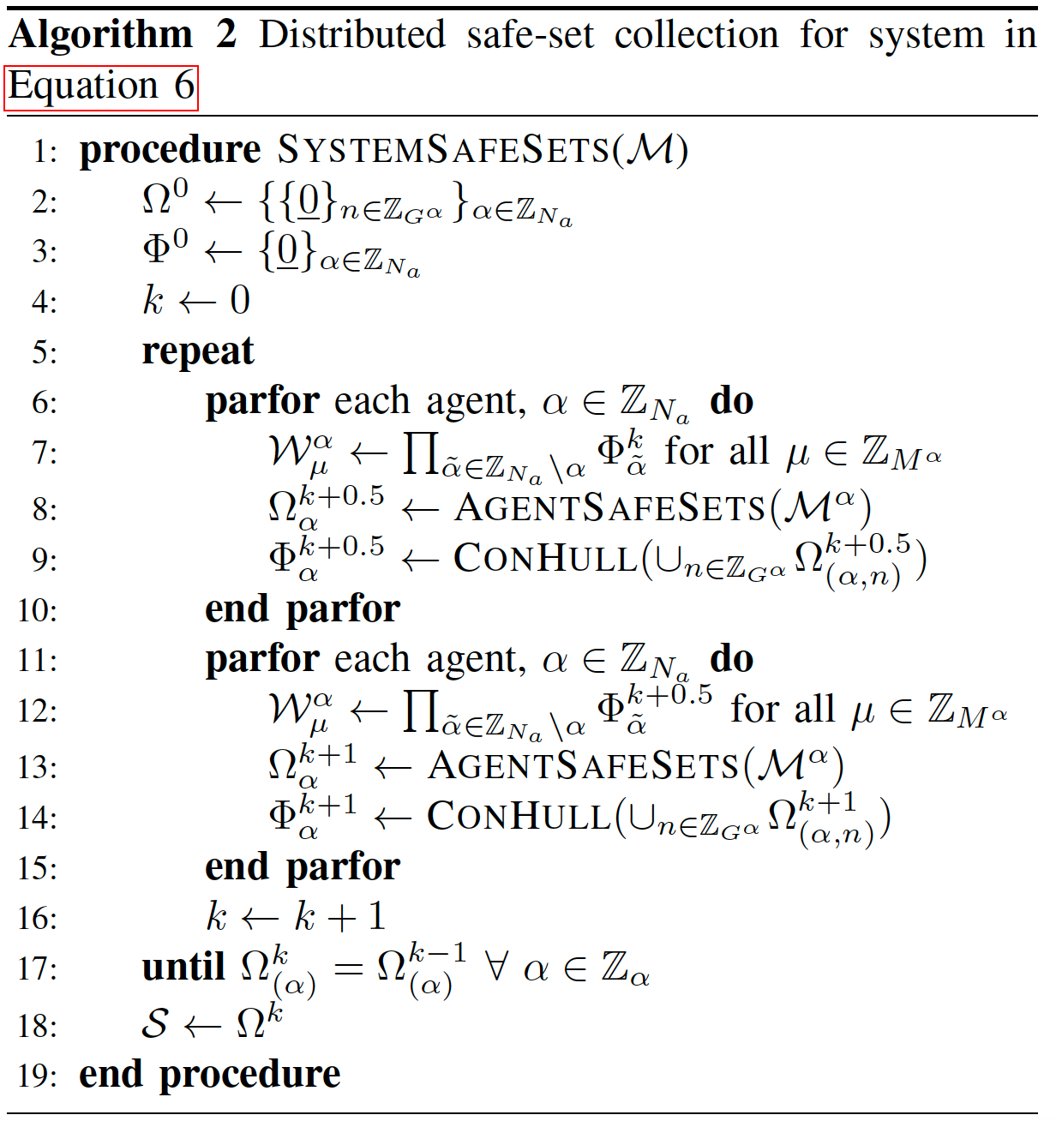
Solution Overview
Algorithm Design – Parallelized Algorithm
Start with trivial feasible regions (equilibrium points).

Slide 12
Solution Overview
Algorithm Design – Parallelized Algorithm
Start with trivial feasible regions (equilibrium points).
Compute safe-sets while assuming neighbors are using equilibrium points.

Slide 13
Solution Overview
Algorithm Design – Parallelized Algorithm
Start with trivial feasible regions (equilibrium points).
Compute safe-sets while assuming neighbors are using equilibrium points.
Share convex hull of new, larger safe-sets.

Slide 14
Solution Overview
Algorithm Design – Parallelized Algorithm
Start with trivial feasible regions (equilibrium points).
Compute safe-sets while assuming neighbors are using equilibrium points.
Share convex hull of new, larger safe-sets.
Recompute safe-sets with larger guesses for neighbors.

Slide 15
Solution Overview
Algorithm Design – Parallelized Algorithm
Provide supporting properties and lemmas

Slide 16
Numerical Example
Description
Coupled spring-mass-damper system with switching masses.

Slide 17
Numerical Example
Complexity
Centralized approach
Actual size would be orders of magnitude larger.

Slide 18
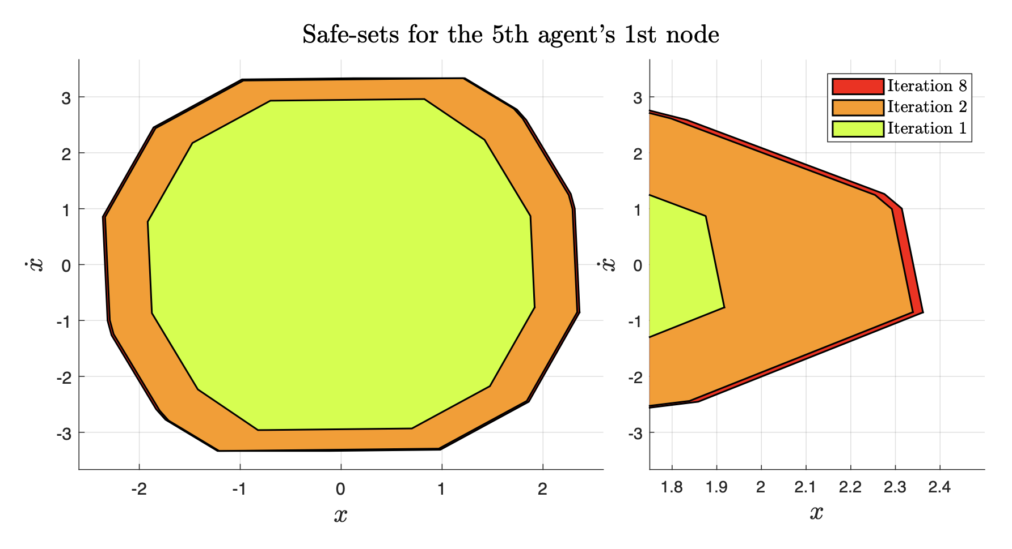
Numerical Example
Results
Display sets and runtime.
Maybe create plots of set areas converging.

Slide 19
Conclusion
Summary of results
Future work

Slide 20
Questions?
Email: Richard.A.Hall@duke.edu

